Slide 1
European Charter for Democratic Schools without Violence

Slide 2
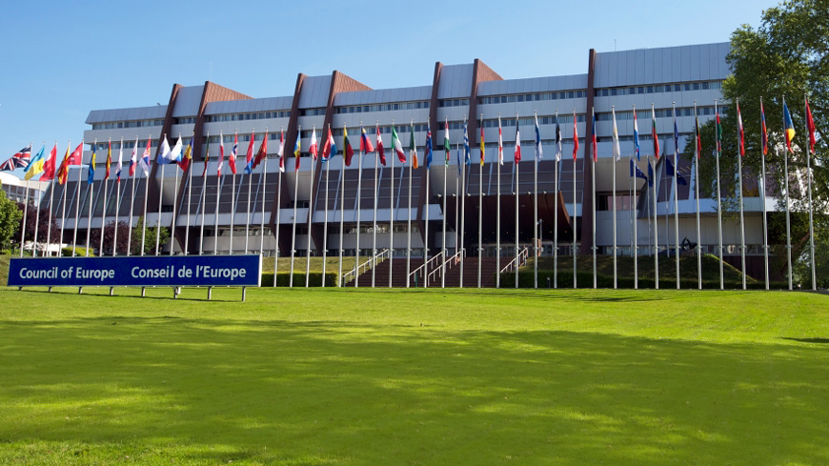
Young people from Europe have prepared this Charter, basing it on the fundamental values and principles set in the Council of Europe’s Convention for the Protection of Human Rights and Fundamental Freedoms.
-Strasbourg, 16 July 2004
This Charter was seriously considered to be used as a model for the Europe’s education systems, it can be utilised as it stands or it can be adapted to the principles of the various school communities, while maintaining its spirit.

Slide 3
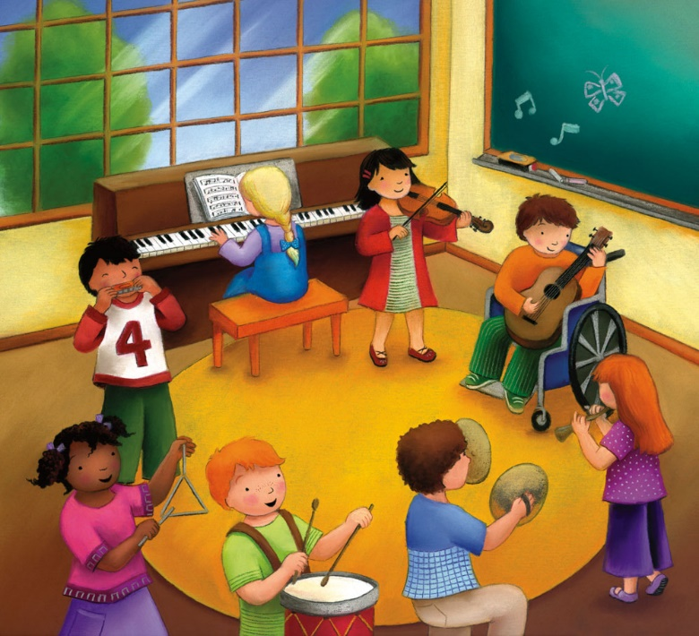
This Charter is made up by 7 points:
1. All members of the school community have the right to a safe and peaceful school. Everybody has the responsibility to contribute to creating a positive and inspiring environment for learning and personal development.

Slide 4
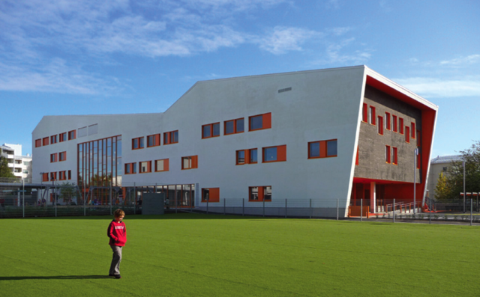
SAFE
PEACEFUL
‘’Protected from or not exposed to danger or risk.‘’
‘’Not likely to cause or lead to harm or injury.‘’
’’Free from disturbance; tranquil.’’
‘’Not involving violence.’’

Slide 5
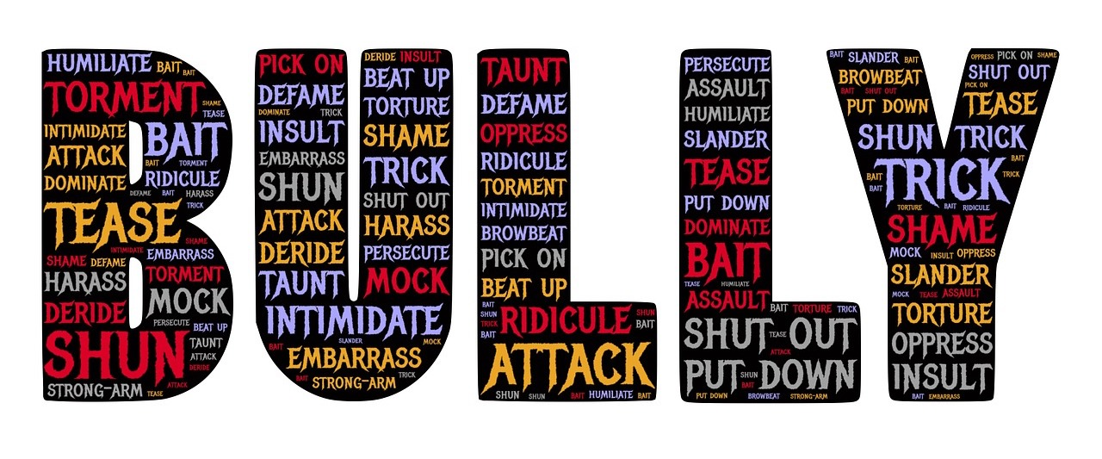
NO PEACE
BULLYING

Slide 6
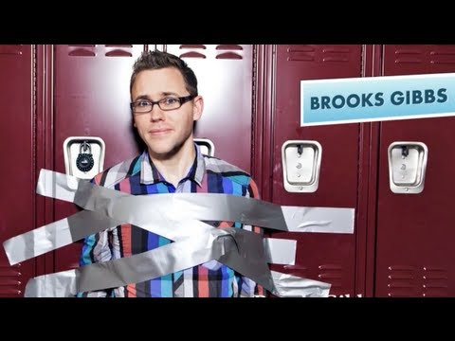
Brooks Gibbs is an award winning social skills educator who teaches students, parents, and teachers how to build emotional resilience and live by the Golden Rule.
In the following video, Brooks Gibbs tries to explain how to fight bullying. Sociologists consider bullying the demonstration of how a person wants to overpower an other person.
He is also known as a bullying expert. Everything he teaches is based to the word ‘’resilience’’, which is ‘’the capacity to recover quickly from difficulties.’’

Slide 8
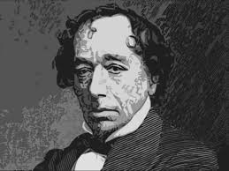
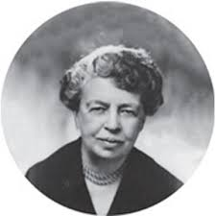
‘’Courage is fire, and bullying is smoke.’’
Benjamin Disraeli
‘’No one can make you feel inferior without your consent’’
Eleanor Roosevelt
‘’If your enemy is in your head, kick them out’’
Brooks Gibbs

Slide 9
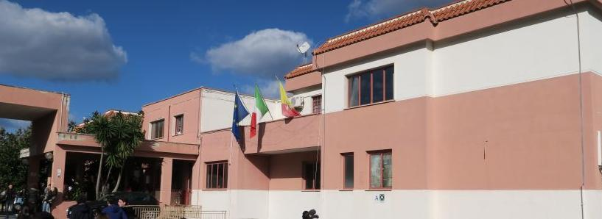
Realized by Alberto Torrente in collaboration with Erika Di Noto.
Liceo Danilo Dolci (Palermo)
Class 4G

